Slide 2
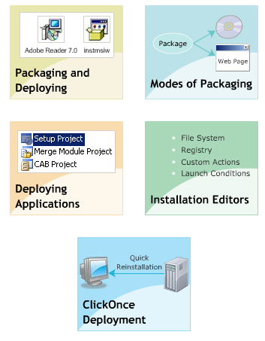
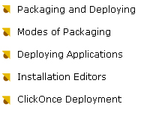
OBJECTIVES

Slide 3
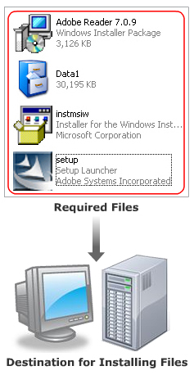
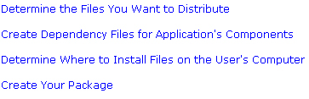
Package

Slide 4
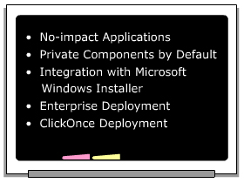
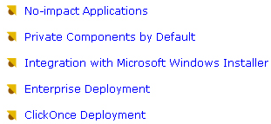
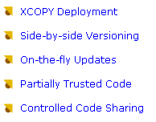
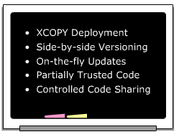
Deploy

Slide 5
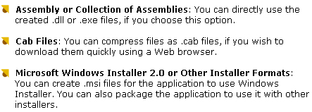
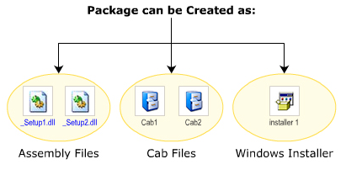
Way to package

Slide 6
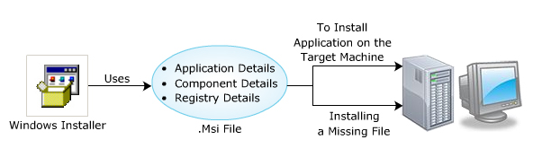
Windows Installer File - .msi file
MSI file is the format of package file
Contains information about application
and its installation
Automatically install the missing files
Cancel installation procedure.

Slide 7
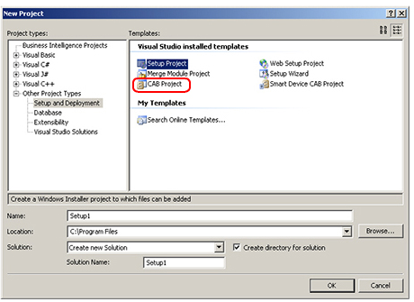
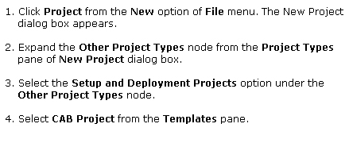
CAB file
Cabinet file
Download components using Web Browser

Slide 8
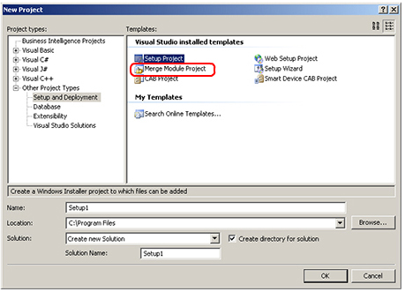
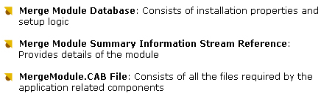
Merge Module
Consists of different shared module, which are use by various application
Is saved as .msm file.
Consits of 3 main components

Slide 9
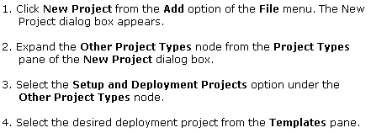
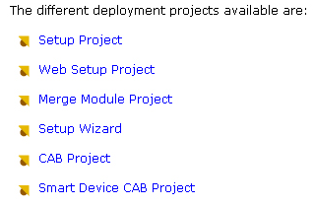
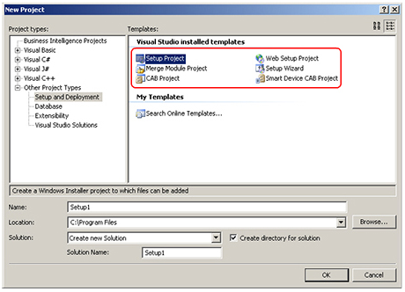
Setup Project

Slide 10
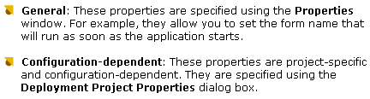
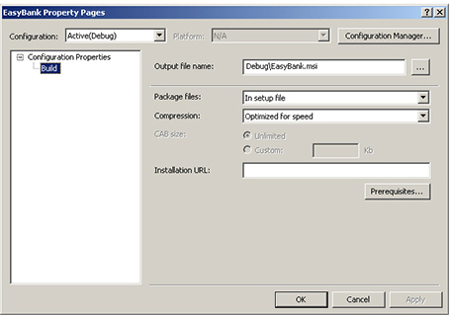
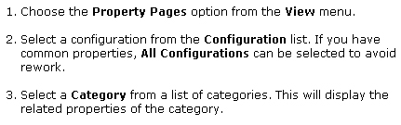
Property Page

Slide 11
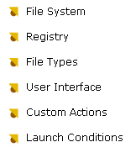
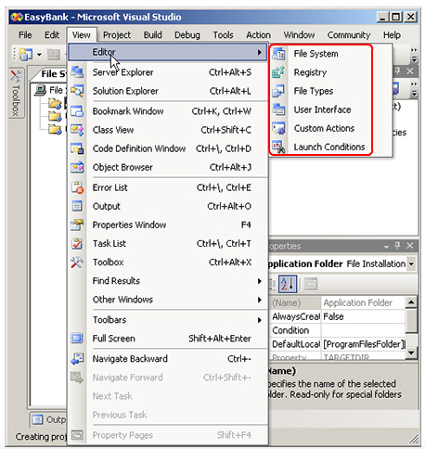
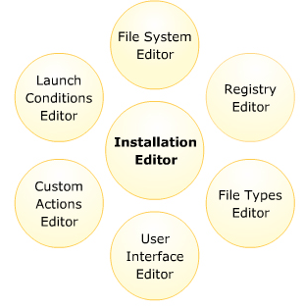
Installation Editor

Slide 12
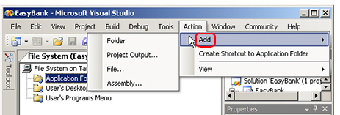
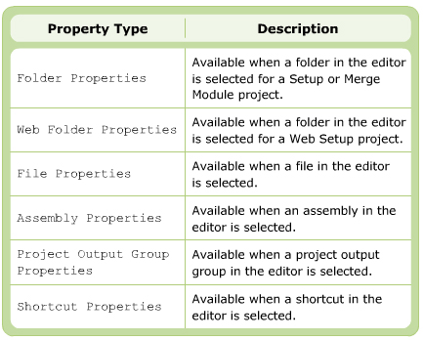
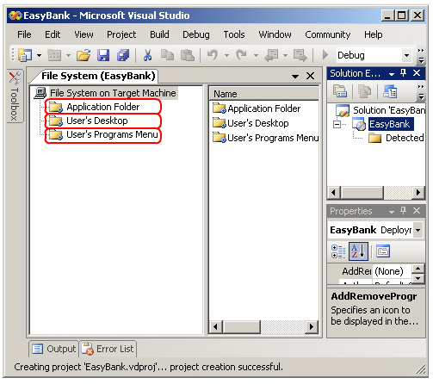
File System Editor
Used to add File , folder, project output and other items
Delete file , folder ..
Open as default

Slide 13
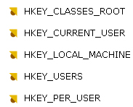
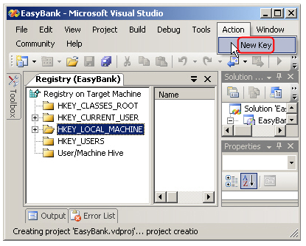
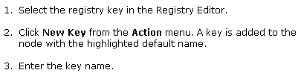
Registry

Slide 14
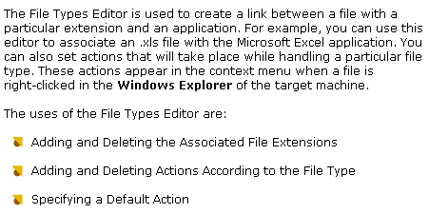
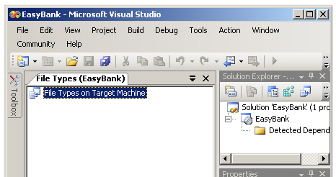
FileType Editor

Slide 15

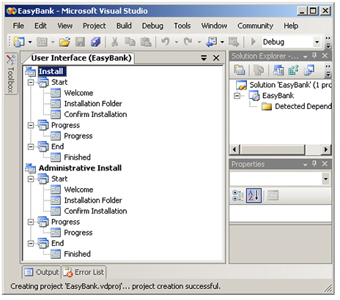

User Interface Editor

Slide 16

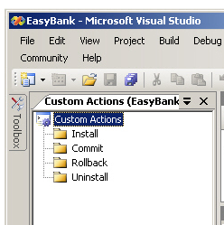
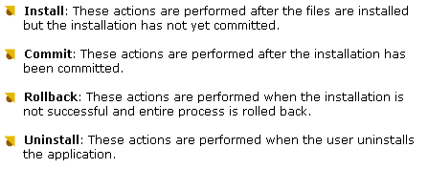
Custom Action Editor

Slide 17
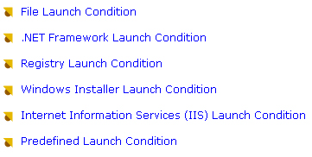
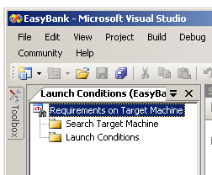
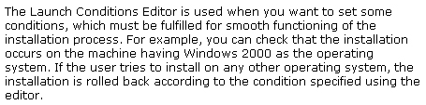
Launch Condition

Slide 18
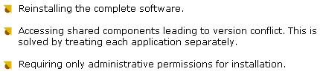
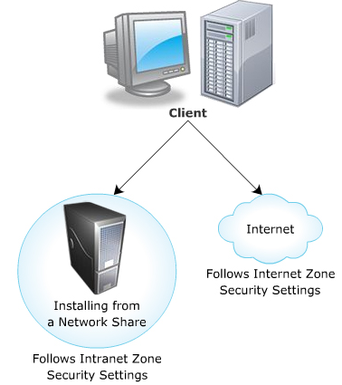

ClickOnce
This a technology which allows you to create auto-updating application
Used when the software frequent change
Install and run : Internet , Intranet
Security must set before installation
Install on user’s local machine
Check for any new version
3 way to publish ClickOnce :

Slide 19


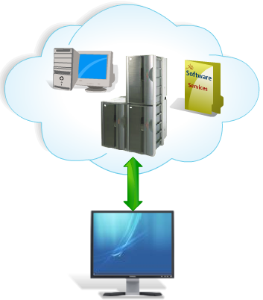
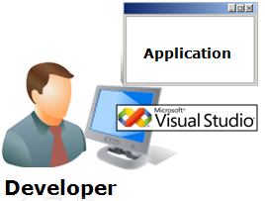
ClickOnce Deployment
Application Planning
Requires lot of
planning and effort
Many issues in
deployment
Application Deployment
ClickOnce Technology
Server
Improved ClickOnce
Easier deployment and installation
Application Development

Slide 20
ClickOnce Deployment
ClickOnce:
Is a deployment technology facilitating creation of self-updating Windows-based applications
Can be used to publish Windows Forms, Windows Presentation Foundation (WPF), console-based applications, and so forth
Any Windows Forms (.exe file), Windows Presentation Foundation (.xbap file), console application (.exe file), or Office (.dll library) solution published using ClickOnce technology is termed as a ClickOnce application
Key features of ClickOnce applications:
Self-contained and isolated from the other
Self-updating
Do not require administrator privileges for installation

Slide 21
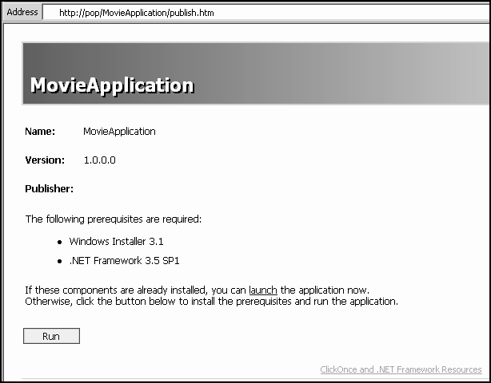
Installing a ClickOnce Application on a Client Computer
You can install a ClickOnce application on a client computer in two ways:
Installing a ClickOnce application from a Web site:
Launch the Publish.htm Web page from the installation URL
Assume that the application named MovieApplication was published to http://localhost/MovieApplication, and the machine name was named pop, the Publish.htm file would be located at http://pop/MovieApplication/publish.htm
Click Run and follow the steps (if any) in the Install wizard

Slide 22
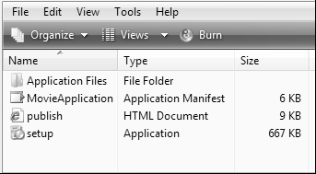
Installing a ClickOnce Application on a Client Computer
To install a ClickOnce application from a file share:
Open the file share
Double-click Setup and follow the steps (if any) in the Install wizard

Slide 23
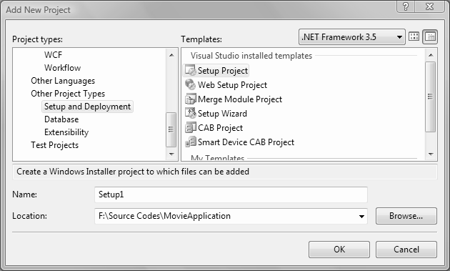
Windows Forms Setup applications
After compilation, a setup project generates an .msi file which includes a setup wizard for the application
On double-clicking the .msi file, installation begins
Each setup project includes six editors that allow to configure the contents and the behavior of the setup project
These six editors are:
File System Editor
Registry
File Types
User Interface
Custom Actions
Launch Conditions
Setup projects enable you to create Windows Installer files for the solutions
Setup projects are configurable to a great extent
Add a setup project to the solution as follows:
Open the solution in Visual Studio 2008
Choose File→Add→ New Project to open the Add New Project dialog box
Expand Other Project Types in the Project Types pane and click Setup and Deployment as shown
Click Setup Project in the Templates pane, and then click OK
Creating Setup Project

Slide 24
Summary

